Slide 1

Chapter 7： DC-DC Switch-Mode Converters:
7-1 Introduction
7-2 Control of dc-dc Converters
7-3 Step-Down (Buck) Converter
7-4 Step-Up (Boost) Converter
7-5 Buck-Boost Converter
7-6 Cuk dc-dc Converter
7-7 Full Bridge dc-dc Converter
7-8 dc-dc Converter Comparison

Slide 2
本章知识点：
1、掌握Buck变换器、Boost变换器和Buck-Boost变换器的工作原理和参数设计；
2、理解Cuk变换器的工作原理和性能。

Slide 3
7-1 Induction
The dc-dc converters are widely used in regulated switch-mode dc power supplies and in dc motor drive applications.
DC
unregulated
DC
unregulated
AC
Uncontrolled diode rectifier
Filter capacitor
DC-DC converter
DC
regulated
Battery
Load
Figure7-1 A dc-dc converter system

Slide 4
1 Assumptions:
The converter operating in steady state
The switches are ideal
The losses in the inductive and capacitive elements are neglected
The dc input voltage to the converters is purely dc voltage and has zero internal impedance
The output loads are resistance (in case of switch-mode dc power supply load) or resistance-inductance (in case of dc motor load)
2 Analysis technique:
Average KVL, KCL

Slide 5
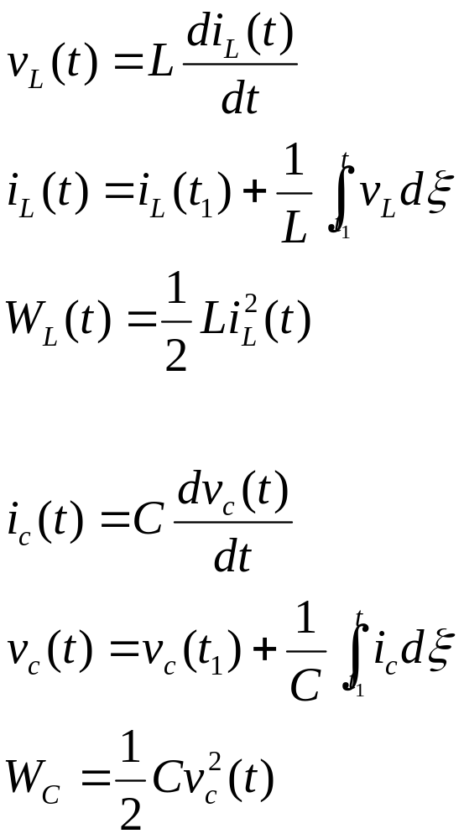
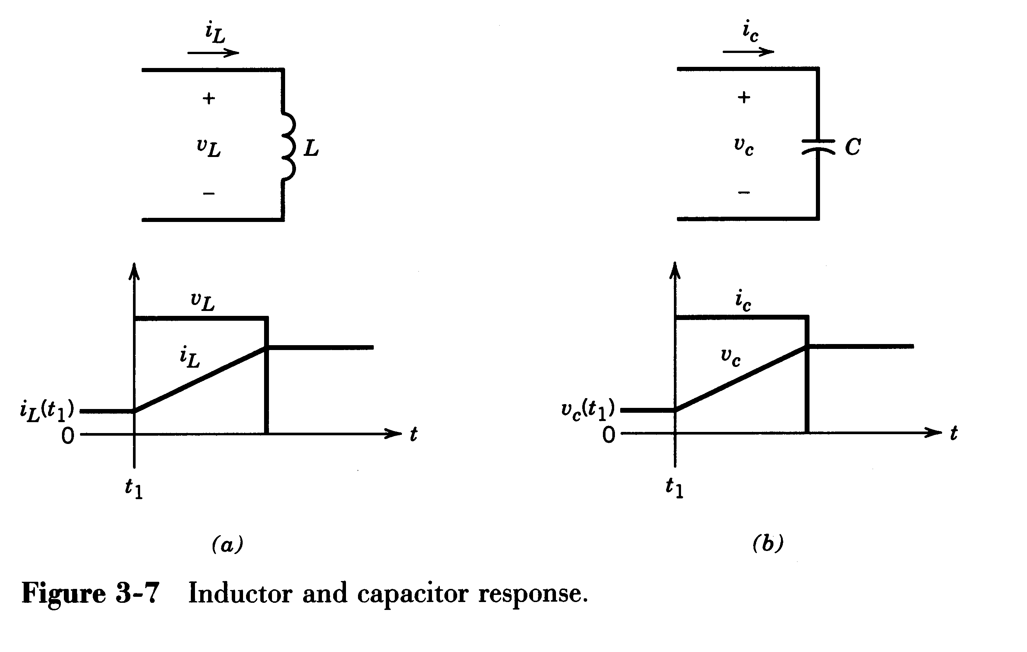
3 Review of basic Electrical Circuit Concepts (in Chapter 3) :
(1) Response of L and C

Slide 6
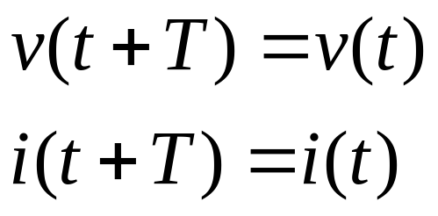
(2) Voltage and Current in Steady State
A steady-state condition:
the voltage and current waveform repeat with a time period T, that is:

Slide 7
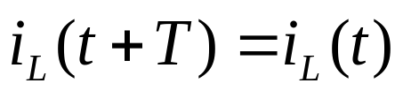
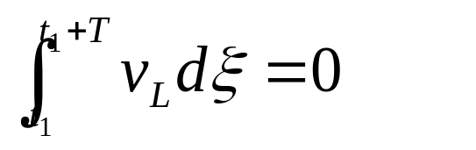
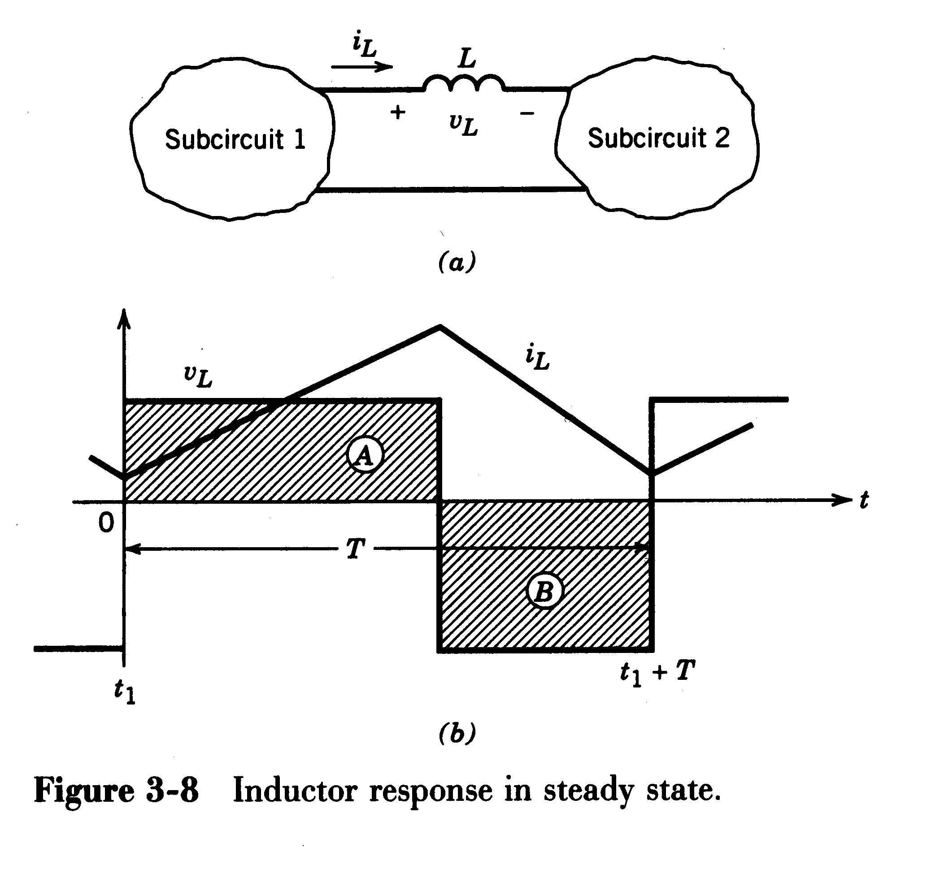
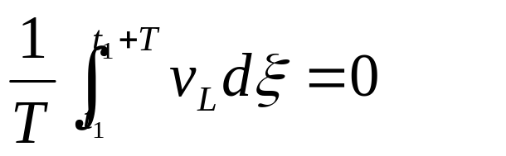
① In case of an inductor operating under a steady-state condition:
Volt-seconds over T equal zero.
Average inductor voltage over T equal zero.

Slide 8
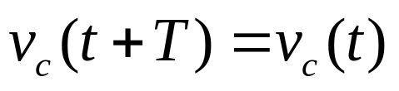
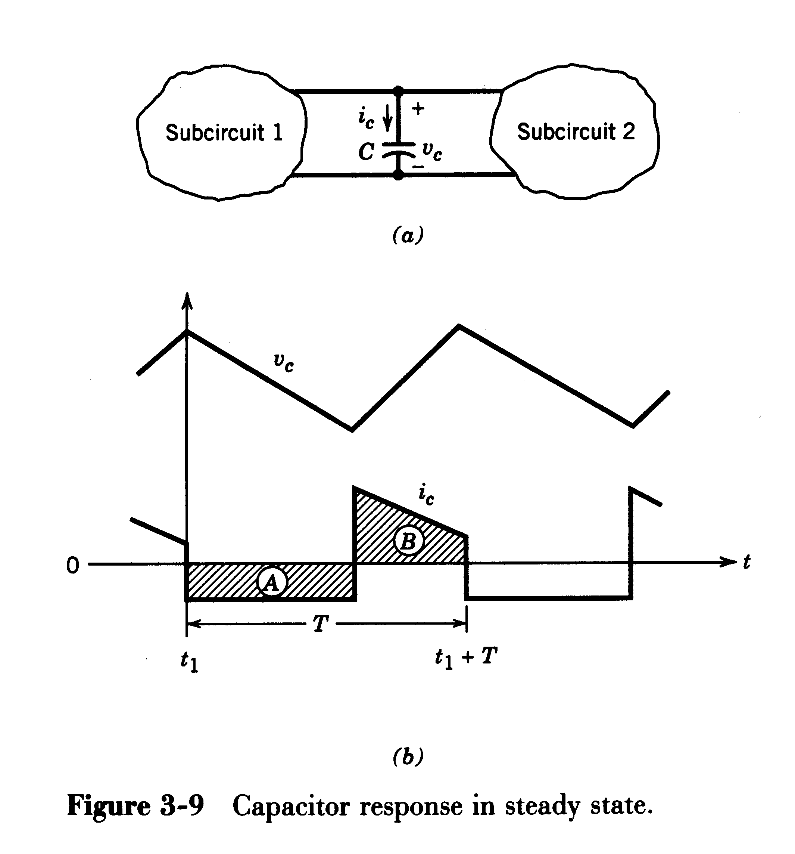
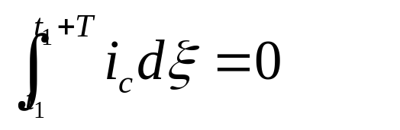
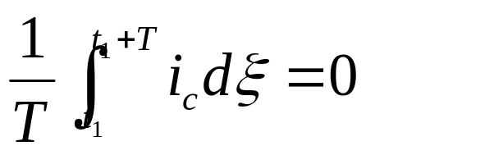
② In case of a capacitor operating under a steady-state condition:
Amp-seconds over T equal zero.
Average capacitor current over T equal zero.

Slide 9
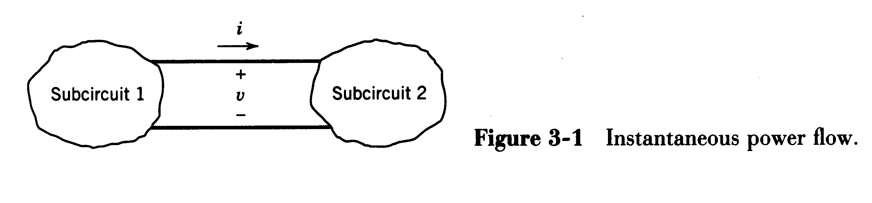

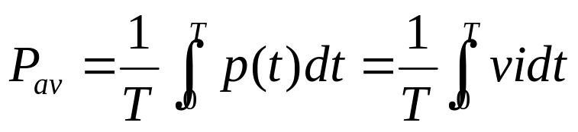
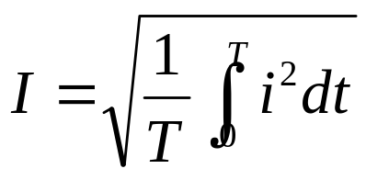
(3) Power and Current
Instantaneous power
Average Power
rms Current （有效值电流）

Slide 10
7-2 Control of dc-dc Converter
1 A basic dc-dc converter (idea of DC chopper)
v_{o}
+
V_{d}
-
+
V_{o}
-
V_{d}
V_{o}
R
t
t_{on}
t_{off}
T_{s}
Figure 7-2 switch-mode dc-dc converter
Operating principle:
The output voltage V_{o} depends on t_{on} and t_{off}.
Switch duty ratio （占空比） D=t_{on}/T_{s}.

Slide 11
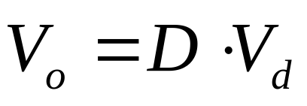
v_{o}
+
V_{d}
-
+
V_{o}
-
V_{d}
V_{o}
R
t
t_{on}
t_{off}
T_{s}
Figure 7-2 switch-mode dc-dc converter
How to realize duty ratio control of chopper?

Slide 12
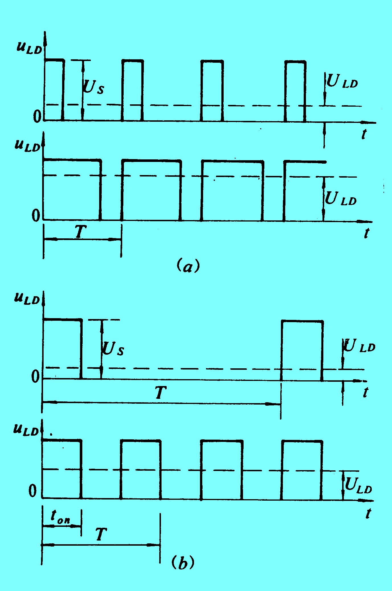
2 Control methods ☆
⑴ PWM (pulse-width modulation 脉宽调制) control:
Switching at a constant frequency f_{s} (T_{s}) and adjusting the on duration t_{on}.
⑵ PFM (pulse-frequency modulation 脉冲频率调制) control:
Switching at a constant t_{on} and adjusting the frequency f_{s} (T_{s}).
⑶ Other control:
Both Switching frequency f_{s} (T_{s}) and the on duration t_{on} are varied.

Slide 13
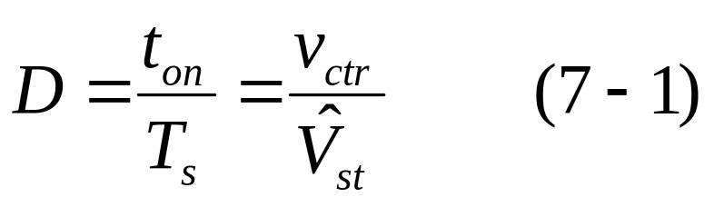
PWM (pulse-width modulation) control
V_{ref}
+
Amplifier
-
v_{ctr}
Switch control signal
V_{o}
Comparator
v_{st}
v_{st}
v_{ctr}
Figure 7-3
on
on
V_{ctr}>v_{st}
Switch control signal
off
off
V_{ctr}<v_{st}
V_{ctr}: signal-level control voltage
V_{st}: desired output voltage
V_{o}: actual output voltage

Slide 14
7-3 Step-Down (Buck) Converter
降压变换器or BUCK变换器
Applications: Step-down converter is mainly applied in regulated dc power supplies and motor speed control.
Conceptually, A basic dc-dc converter (as below) constitutes a step-down converter for purely resistive load.
v_{o}
+
V_{d}
-
+
V_{o}
-
V_{d}
V_{o}
R
t
t_{on}
t_{off}
T_{s}
Figure 7-2 switch-mode dc-dc converter

Slide 15
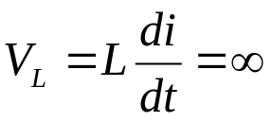
7-3 BUCK CONVERTER
Problem with ideal DC chopper
a. Most load requires constant DC voltage
b. Many loads are inductive loads because of long cable or big winding
+
V_{d}
-
v_{o}
+
V_{o}
-
t
i_{o}
i_{o}
t
Ideal DC chopper has two drawbacks: (1) has no “freewheels” path for inductive energy flow; (2) the output voltage fluctuates（波动） between zero and V_{d}.

Slide 16
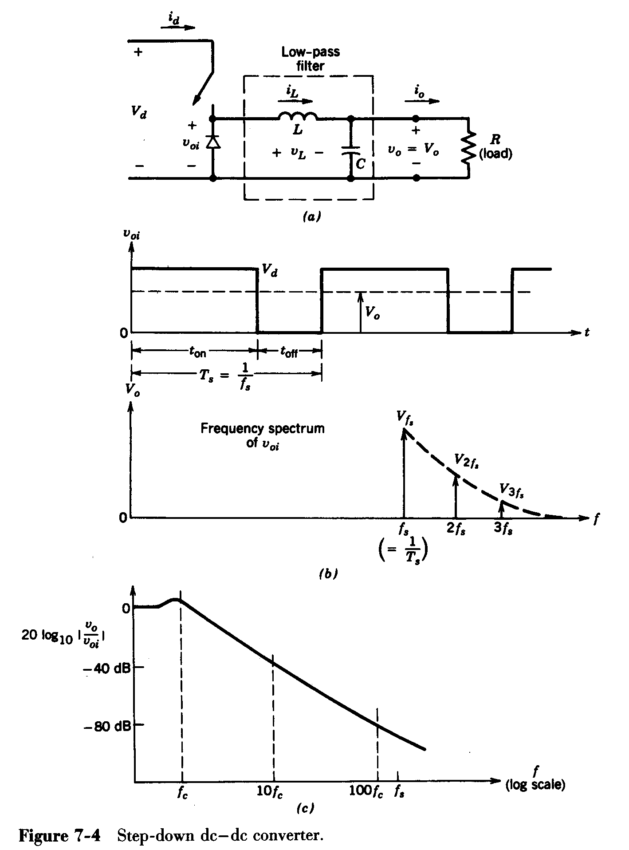
7-3 BUCK CONVERTER
How the Buck Converter is Derived?
Practical Buck Converter
(DC Chopper + Low Pass filter)
The problem of stored inductive energy is overcome by using a diode.
The output voltage fluctuations are very much diminished by using a low-pass filter.

Slide 17
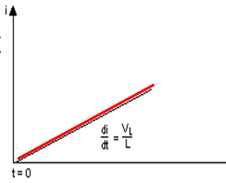
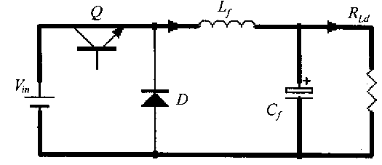

Operating principle of Buck Converter
Charge phase
Power Electronics
Zhang Liwei(张立伟)

Slide 18
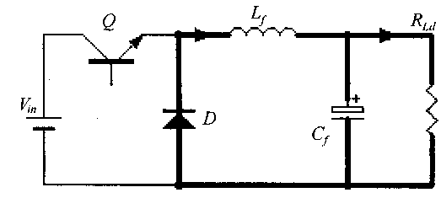
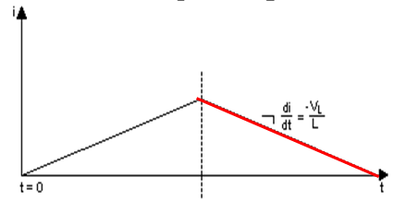
Operating principle of Buck Converter
Discharge phase
Key note:
In steady state, the inductor current will resume at the end of each cycle!
Power Electronics
Zhang Liwei(张立伟)

Slide 19
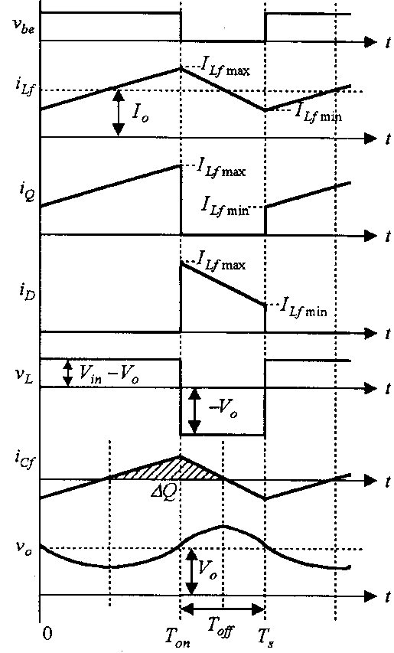
Operating principle of Buck Converter
Charge phase
Discharge phase
Power Electronics
Power Electronics
Zhang Liwei(张立伟)

Slide 20
7-3 BUCK CONVERTER
7-3-1 continuous-conduction mode ☆
Simplifying Assumptions
1.Transistors, diodes and other passive components are all ideal.
2. The input is a pure dc voltage V_{d}.
3. The output voltage is purely dc without any ripple（纹波）, that is v_{o}(t) ≈V_{o},
4. Continuous conduction mode, CCM（连续导电模式）
i_{d}
i_{L}
i_{o}
+
V_{d}
-
+
v_{oi}
-
L
+
v_{o}=V_{o}
-
+ v_{L} -
R
C
(a)
v_{oi}
V_{d}
V_{o}
O
t
t
on
t
off
T
=
1
S
f
s
(b)

Slide 21
7-3 BUCK CONVERTER
i_{d}
i_{L}
i_{o}
1 Operation principle （工作原理）
+
V_{d}
-
+
v_{oi}
-
L
+
v_{o}=V_{o}
-
(a)
+ v_{L} -
R
C
(1) During the t_{on},
The diode becomes reverse-biased and the input provides energy to the load as well as to the inductor, i_{L} linearly increased.
v_{L}
(V_{d}-V_{o})
A
t
(b)
B
(-V_{o})
T_{s}
i_{L}
(2) During the t_{off},
The inductor current “freewheels” through the diode, transferring some of its stored energy to the load, i_{L} linearly decreased.
(I_{L}=I_{o})
(c)
0
t
t_{on}
t_{off}
i_{d}
(d)
0
t
i_{D}
(e)
0
t

Slide 22
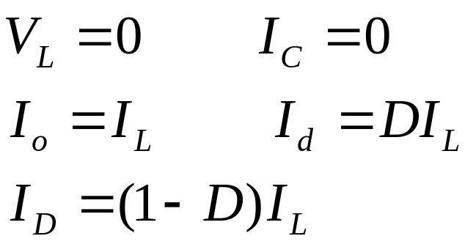
7-3 BUCK CONVERTER
2 Steady-state analysis（稳态分析）:
i_{d}
i_{L}
i_{o}
+
V_{d}
-
+
v_{oi}
-
L
+
v_{o}=V_{o}
-
(a)
+ v_{L} -
R
C
In the dc steady state:
v_{L}
(V_{d}-V_{o})
A
t
(b)
B
(-V_{o})
T_{s}
i_{L}
(I_{L}=I_{o})
(c)
0
t
t_{on}
t_{off}
i_{d}
(d)
0
t
i_{D}
(e)
0
t

Slide 23
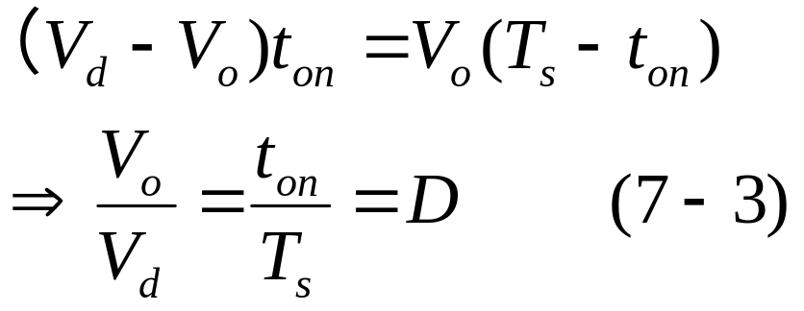
7-3 BUCK CONVERTER
i_{d}
i_{L}
i_{o}
In the dc steady state:
+
V_{d}
-
+
v_{oi}
-
L
+
v_{o}=V_{o}
-
(a)
+ v_{L} -
R
According to “Volt-seconds over T equal zero”, we get:
C
v_{L}
(V_{d}-V_{o})
A
t
(b)
B
(-V_{o})
T_{s}
i_{L}
(I_{L}=I_{o})
(c)
0
t
t_{on}
t_{off}
i_{d}
V_{o} can be controlled by varying the duty ratio D.
(d)
0
t
i_{D}
(e)
0
t

Slide 24
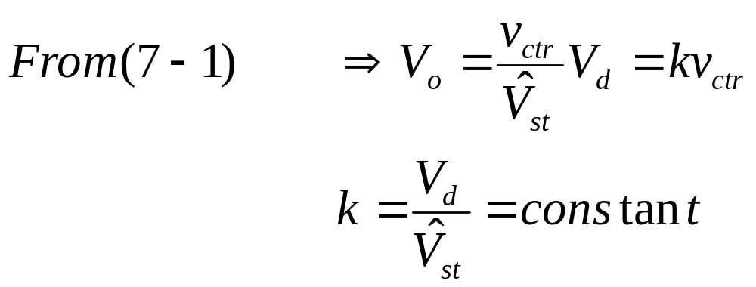
7-3 BUCK CONVERTER
V_{o} varies linearly with the control voltage v_{ctr}.

Slide 25
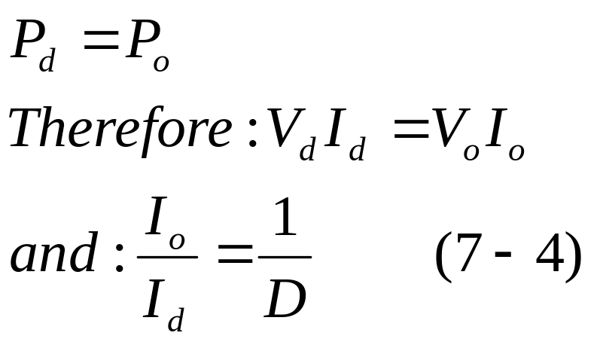
7-3 BUCK CONVERTER
Neglecting power losses associate with all the circuit elements.
i_{d}
i_{o}
+
V_{d}
-
+
v_{oi}
-
L
+
v_{o}=V_{o}
-
(a)
+ v_{L} -
R
C

Slide 26
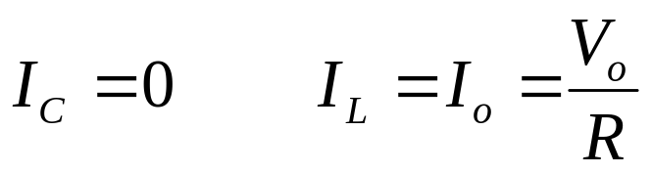
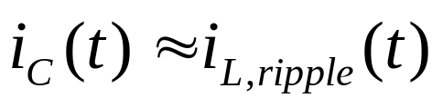
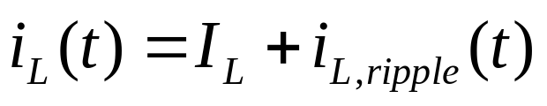
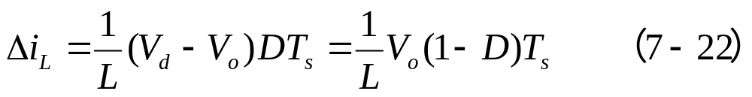
7-3 BUCK CONVERTER
i_{d}
i_{o}
+
V_{d}
-
+
v_{oi}
-
L
+
v_{o}=V_{o}
-
(a)
+ v_{L} -
R
C
v_{L}
(V_{d}-V_{o})
A
t
(b)
B
(-V_{o})
T_{s}
i_{L}
(I_{L}=I_{o})
(c)
0
t

Slide 27
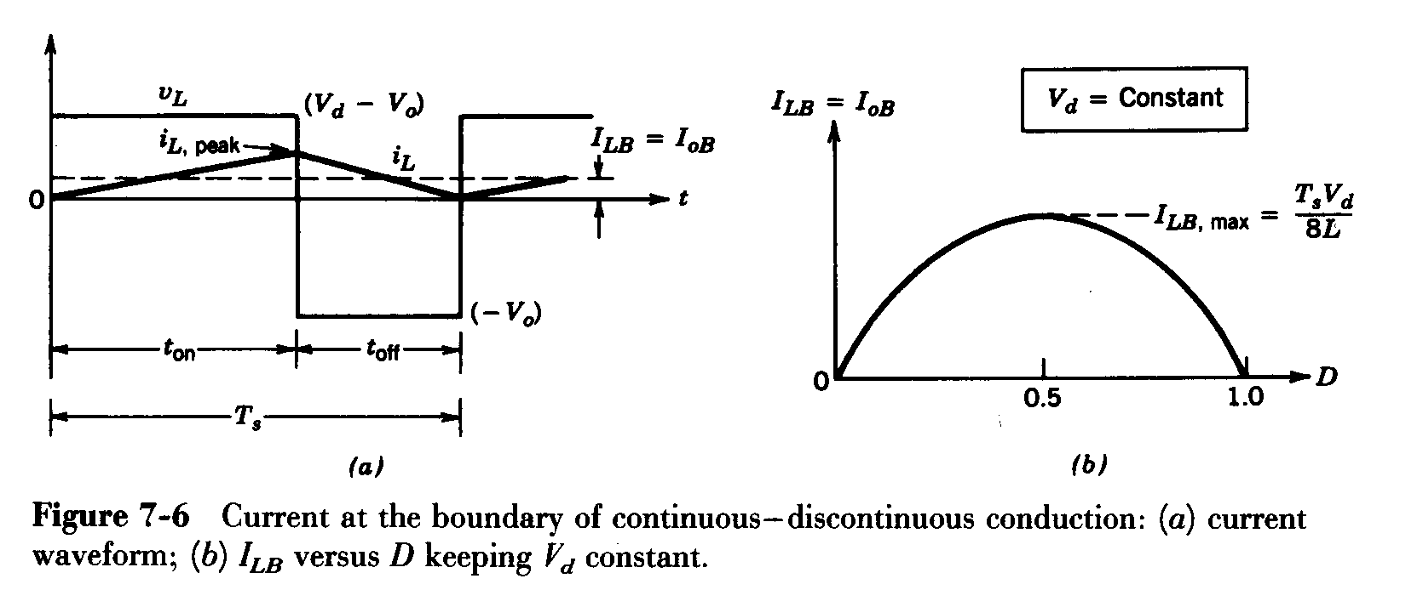
7-3 BUCK CONVERTER
7-3-2 Boundary between continuous and discontinuous-conduction mode
（临界导电模式）
I_{LB}: The average value of the inductor current at boundary
I_{OB}: The average output current at boundary

Slide 28
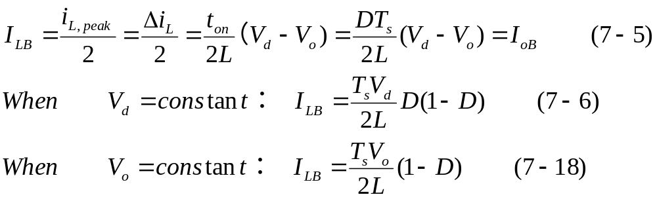
7-3 BUCK CONVERTER

Slide 29
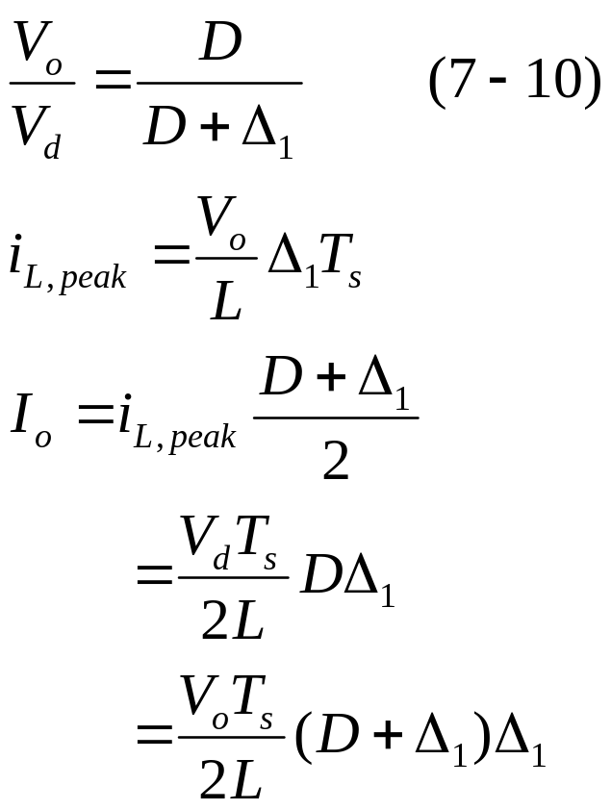
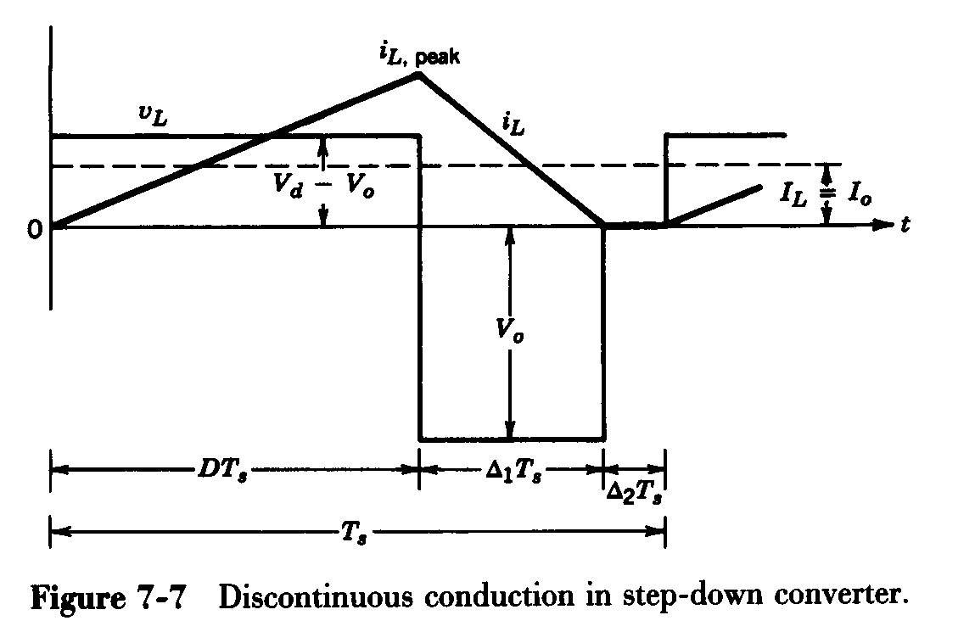
7-3 BUCK CONVERTER
7-3-3 discontinuous-conduction mode
Occurs at light loads
Steady state; inductor current discontinuous

Slide 30
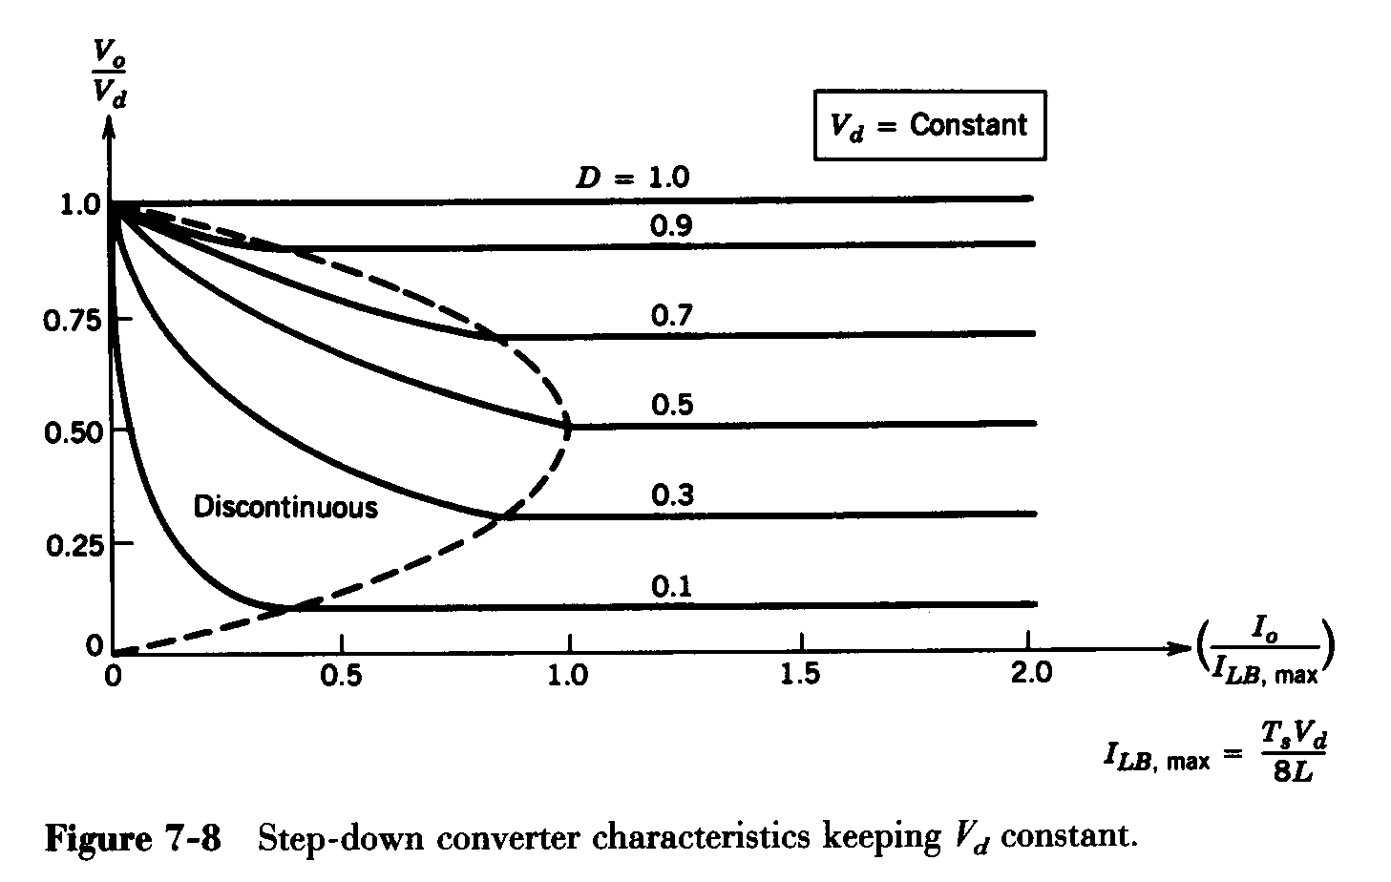
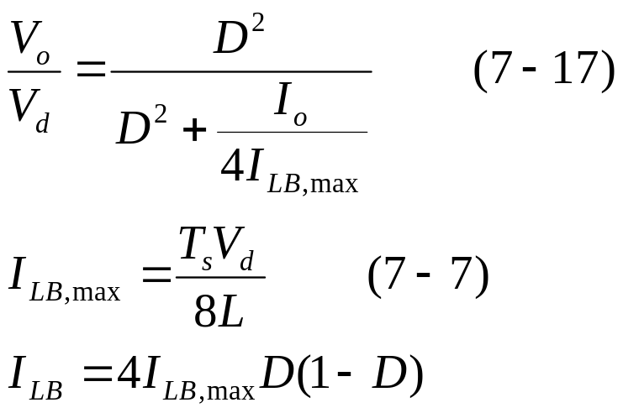
7-3 BUCK CONVERTER
Step-Down DC-DC Converter: Limits of Cont./Discont. Conduction
For a constant V_{d}
The maximum value of I_{LB} occurs at D=0.5

Slide 31
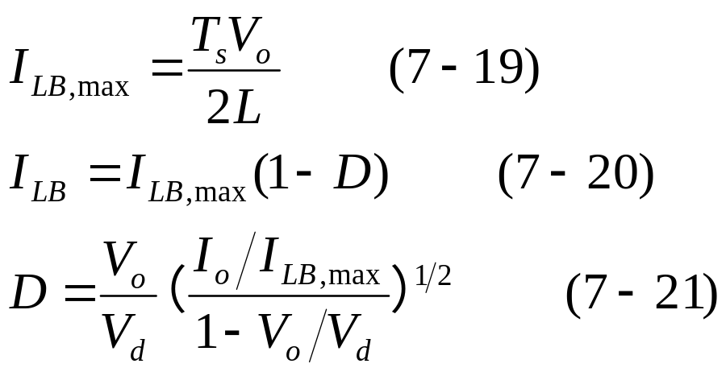
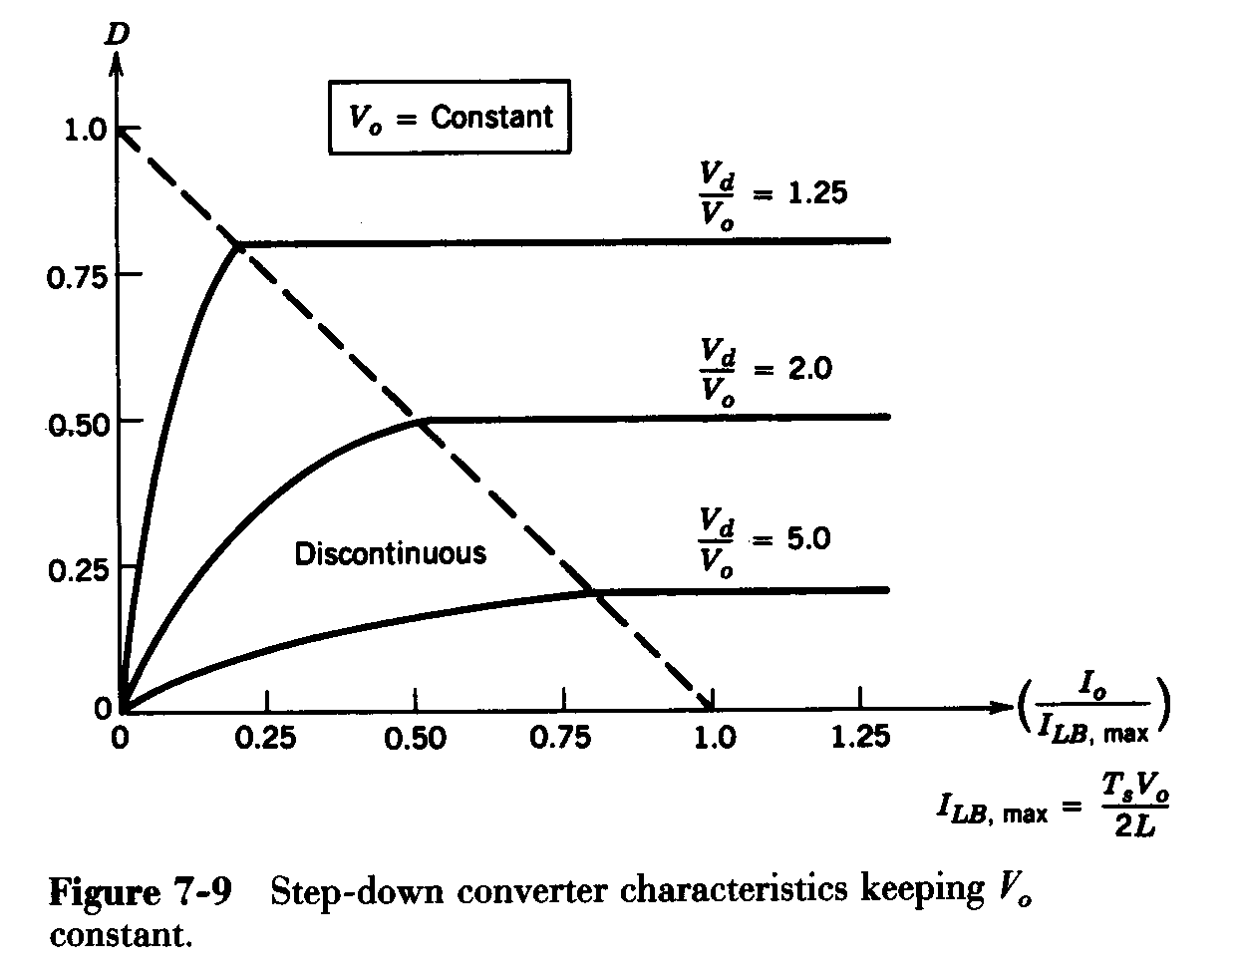
7-3 BUCK CONVERTER
For a constant V_{o}
The maximum value of I_{LB} occurs at D=0.

Slide 32
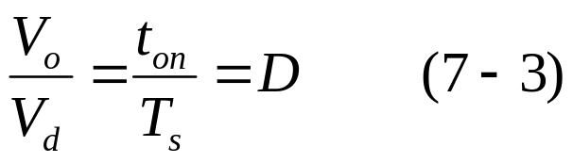
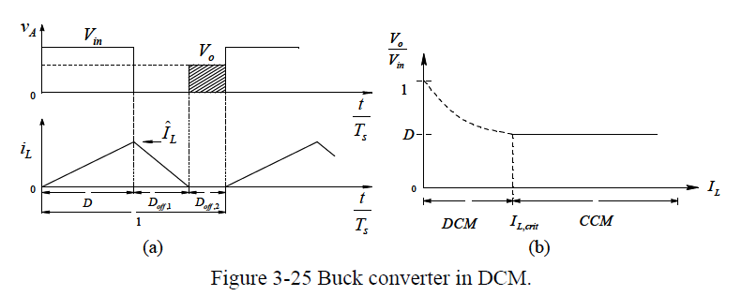
7-3 BUCK CONVERTER
BUCK converter: voltage transfer ratio
The voltage conversion ratio of BUCK converters operating in CCM depends on D, but is independent of the output load. If the output load decreases to the extent that i_{L} becomes discontinuous (DCM), the relationship (7-3) is no longer valid.
Which one will have higher output voltage? CCM or DCM?

Slide 33
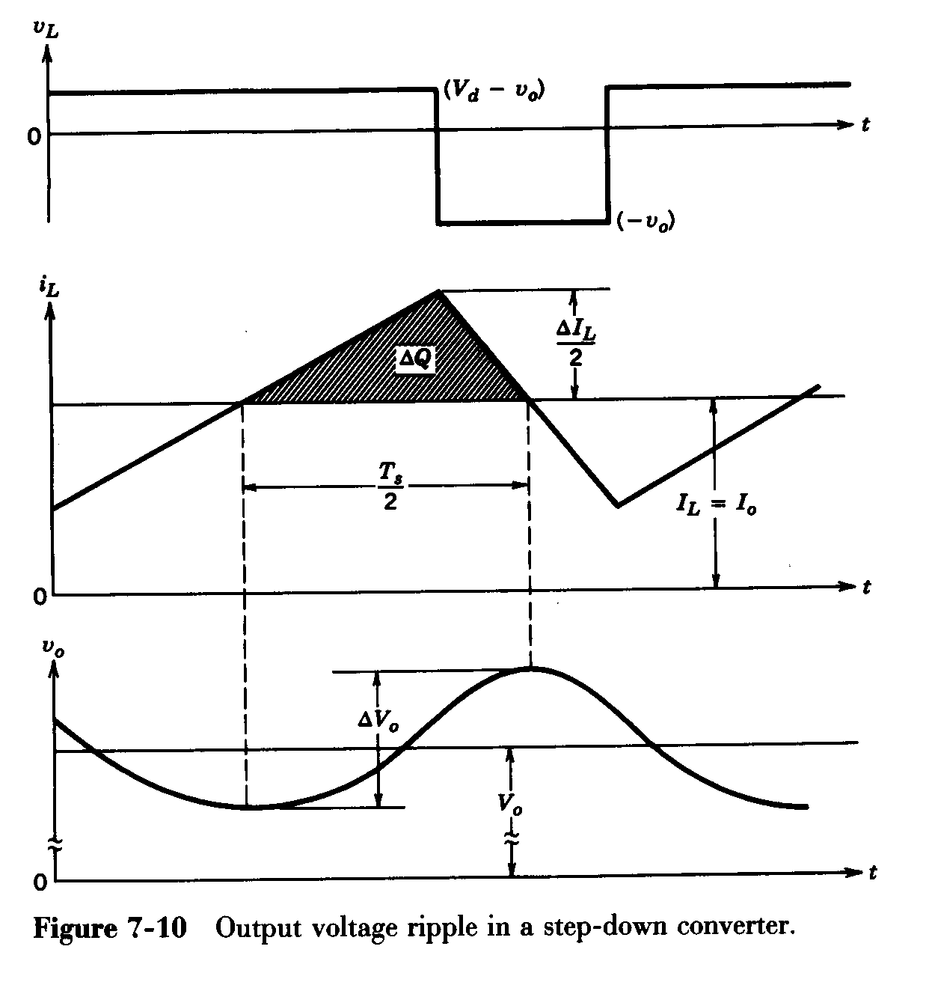
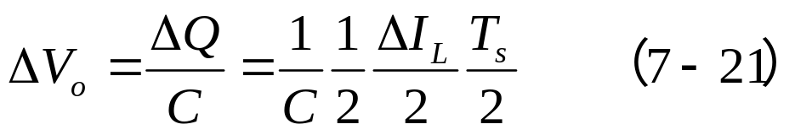
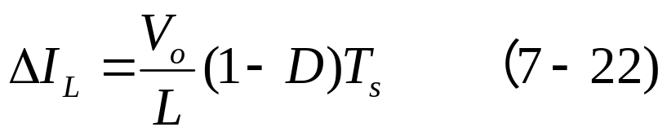
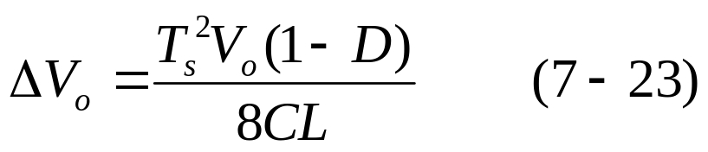
7-3 BUCK CONVERTER
7-3-4 Output voltage ripple
!! For a continuous-conduction mode
Note: in practice, capacitor
equivalent series resistance
(esr) further increases ΔV_{o}.
Note:电容电压波形和电感电流波形没有严格对应

Slide 34
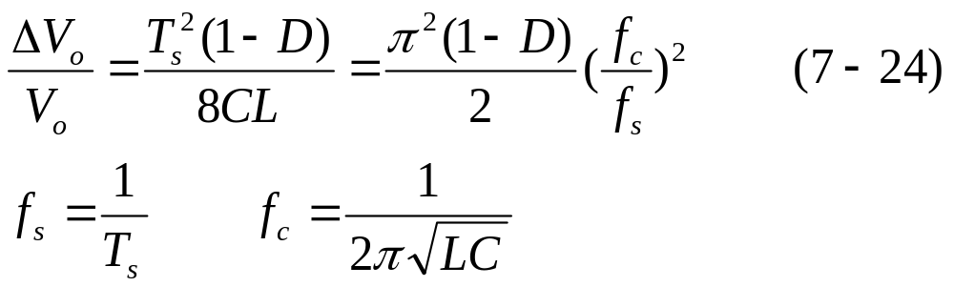
7-3 BUCK CONVERTER
The voltage ripple can be minimized by selecting a corner frequency （截止频率、中心频率）f_{c} of the low-pass filter at the output such that f_{c}<<f_{s}.
The ripple is independent of the output load power.

Slide 35
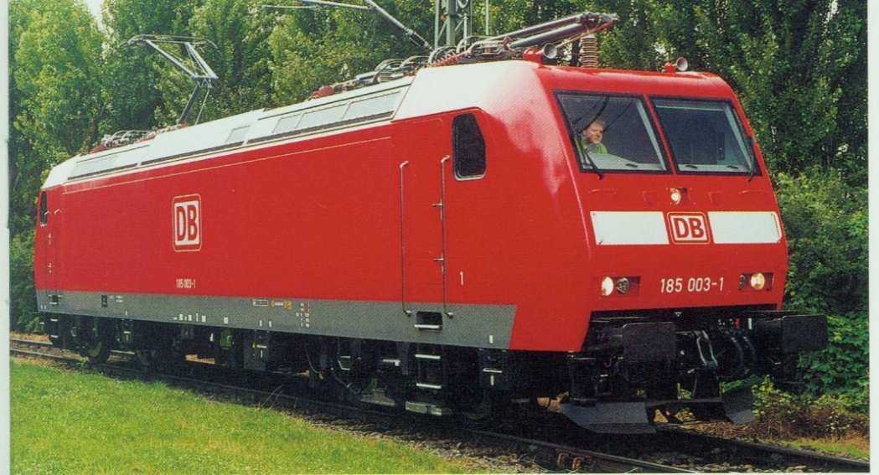
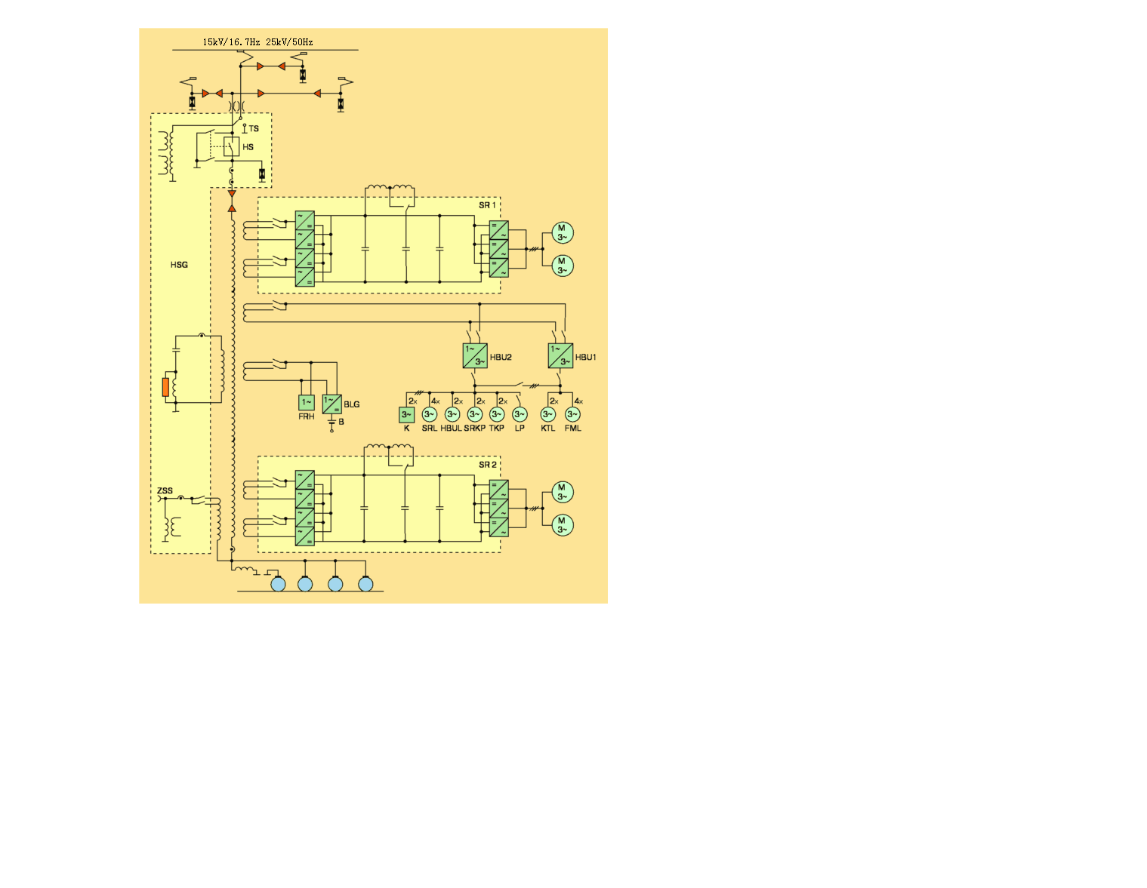
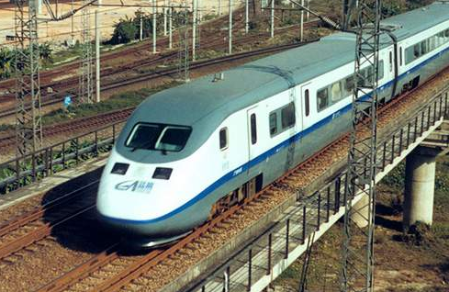

Slide 36

ONIX系统的电路原理图

Slide 37



CRH5动车组牵引辅助系统
CRH5
直交型交流供电系统
先降压后逆变
CRH5的蓄电池充电机结构与CRH1的相似

Slide 38

7-3 BUCK CONVERTER
PSpice Modeling: C:\FirstCourse_PE_Book03\Buckconv.sch

Slide 39

7-3 BUCK CONVERTER
Simulation Results

